Slide 1
The Startup Quadrants
By: Tom Barasa
05/20/2022

Slide 2
Startup Quadrant Analysis
The board of directors at Umoja Enterprises Investment are currently reviewing 1000 potential interesting startups and deciding on which ones to invest in.
The criteria for selecting investments for this fund is a combination of:
High Revenue (2015). Revenue above $8M.
Low Expenses (2015). Expenses must be below $5M.
Top Growth (2015).
The task is to identify which businesses represent the best investment opportunities.

Slide 3
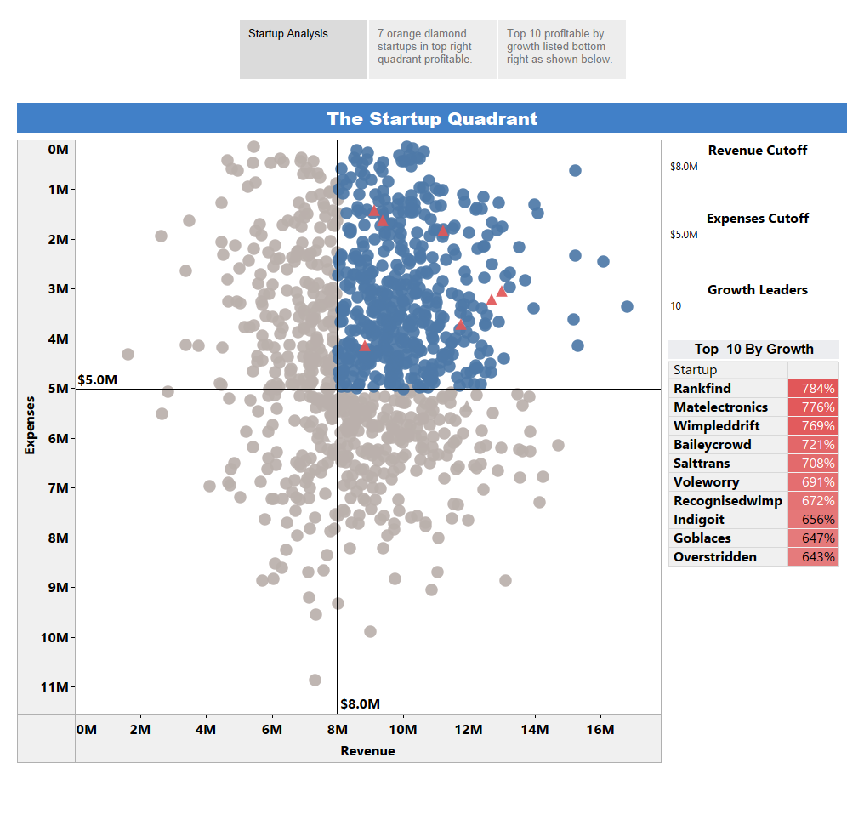

Slide 4
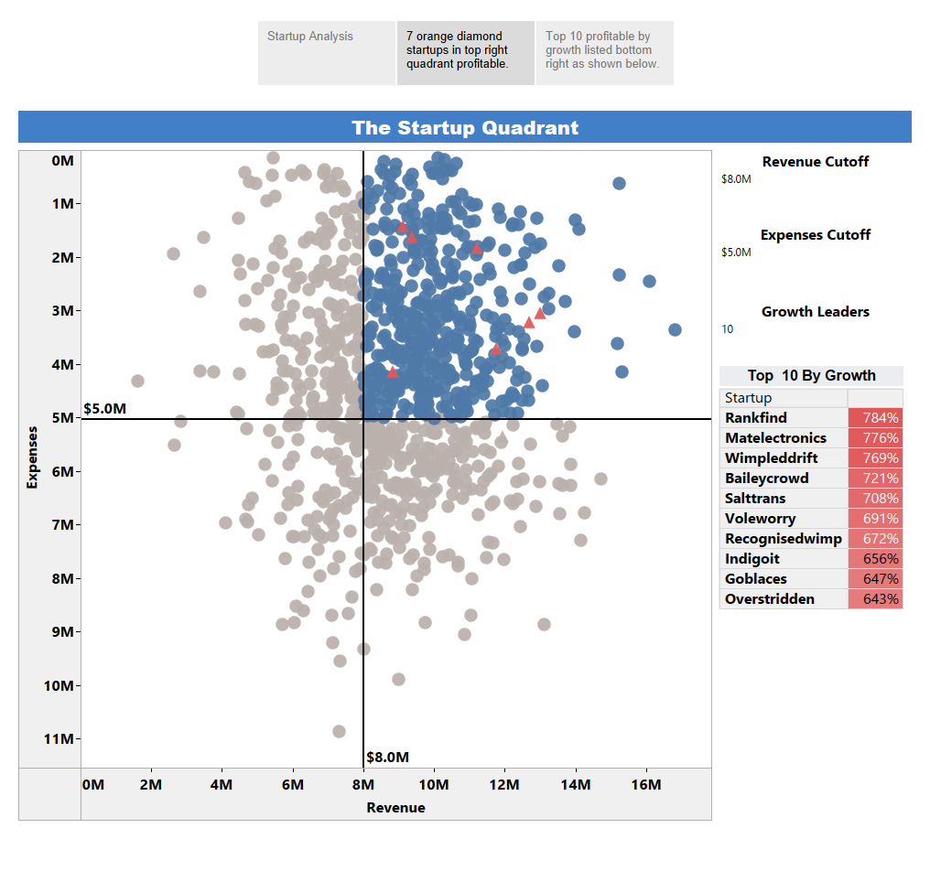

Slide 5
